Slide 1

Shopping Cart Website

Slide 2
Submitted by-
Mohammad Sohaib Khan (201500401)
Gautam Chitransh (201500254)
Submitted to-
Mr. Manoj Varshney

Slide 3
CONTENTS:-
❖ INTRODUCTION
❖OBJECTIVE
❖TECHNOLOGIES USED
❖FRONT END AND BACK END
❖ SCREENSHOTS
❖ CONCLUSION

Slide 4
INTRODUCTION-
With the evolution of technology and the wave of digitalization, more and more businesses are adapting to tech evolutions. You will find the digital payment options with the grocery sellers & street-side vendors as well. The ultimate purpose behind this evolution is to make shopping a hassle-free experience for everyone.
If you are also non-techies who want to take their business online, Builderfly can be your savior. Builderfly is an ecommerce platform exclusively designed for individuals & businesses to start selling online, market & grow their business without any technicalities. So take your business to the World at your own pace.

Slide 5
Type Of Ecommerce Website-:
Business-to-Consumer (B2C)
Business-to-Business (B2B)
Consumer-to-Business (C2B)
Consumer-to-Consumer (C2C)

Slide 6
OBJECTIVE
In our day to life it is difficult to get time for going outside for shoping.
We provide 24/7 service of online Shoping.

Slide 7
TECHNOLOGIES USED
HTML
CSS
JAVASCRIPT
PHP
MYSQL DATABASE

Slide 8
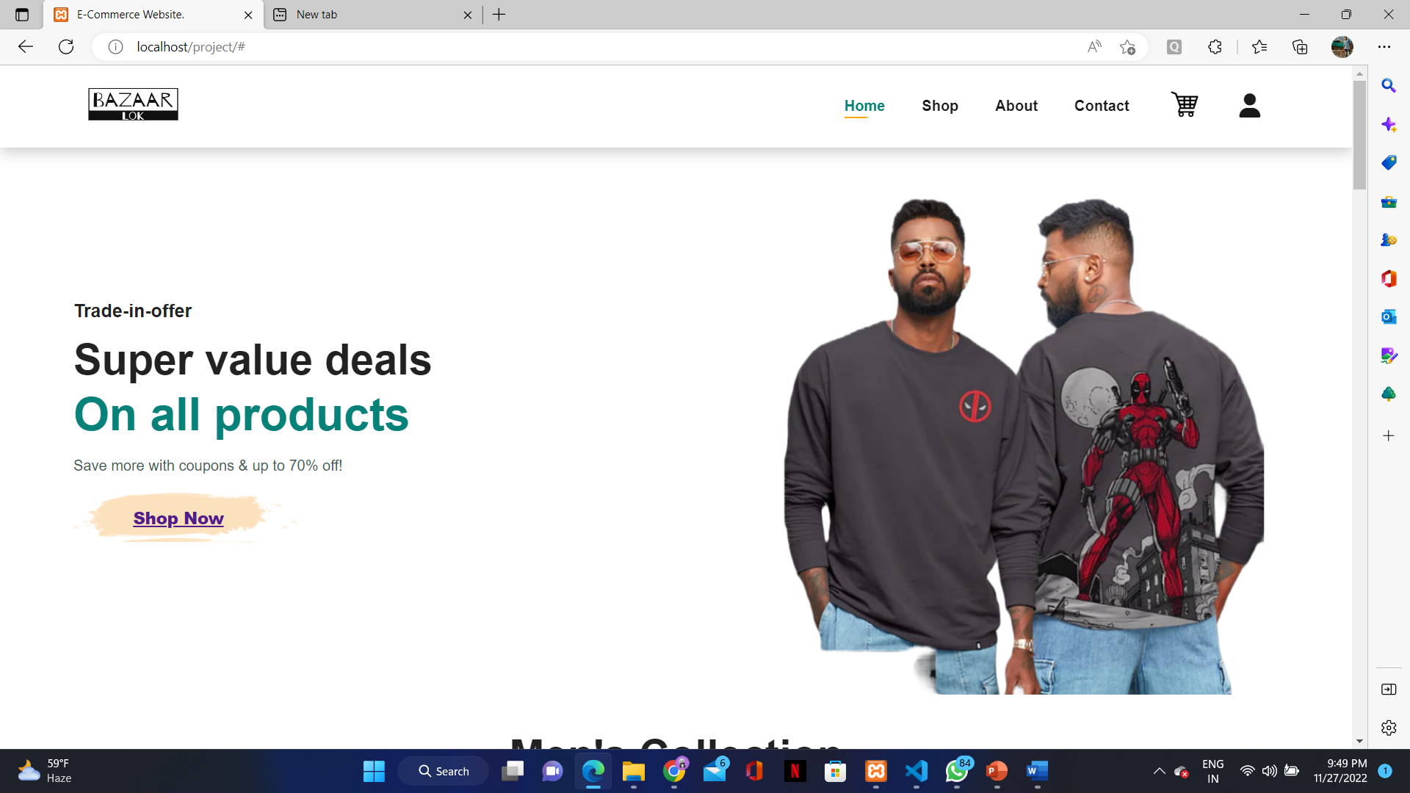
HOME PAGE

Slide 9
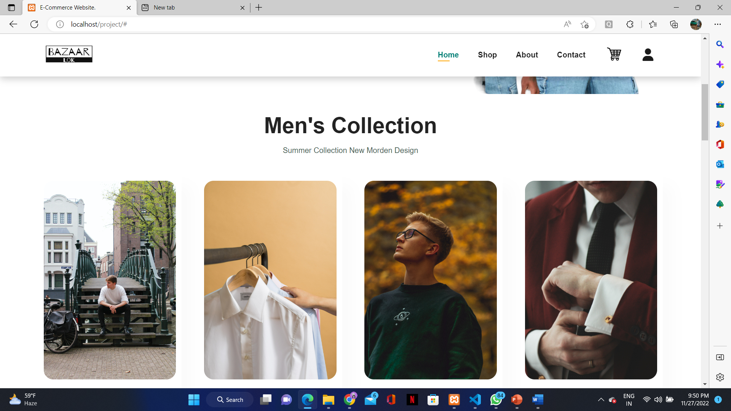
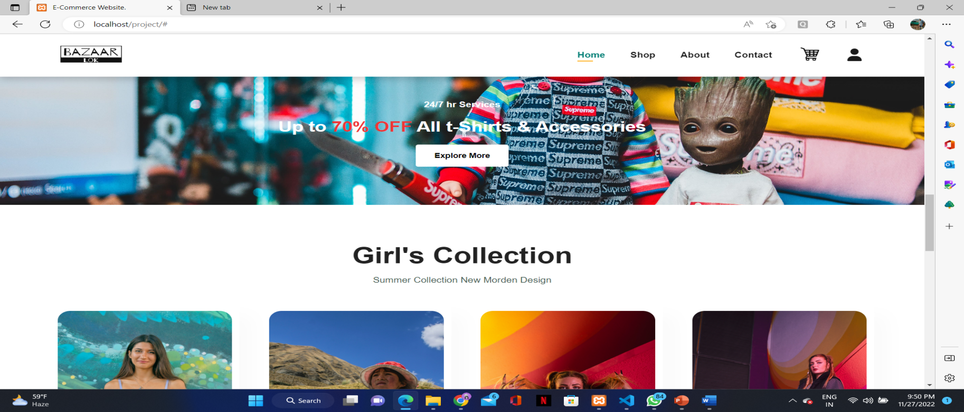

Slide 10
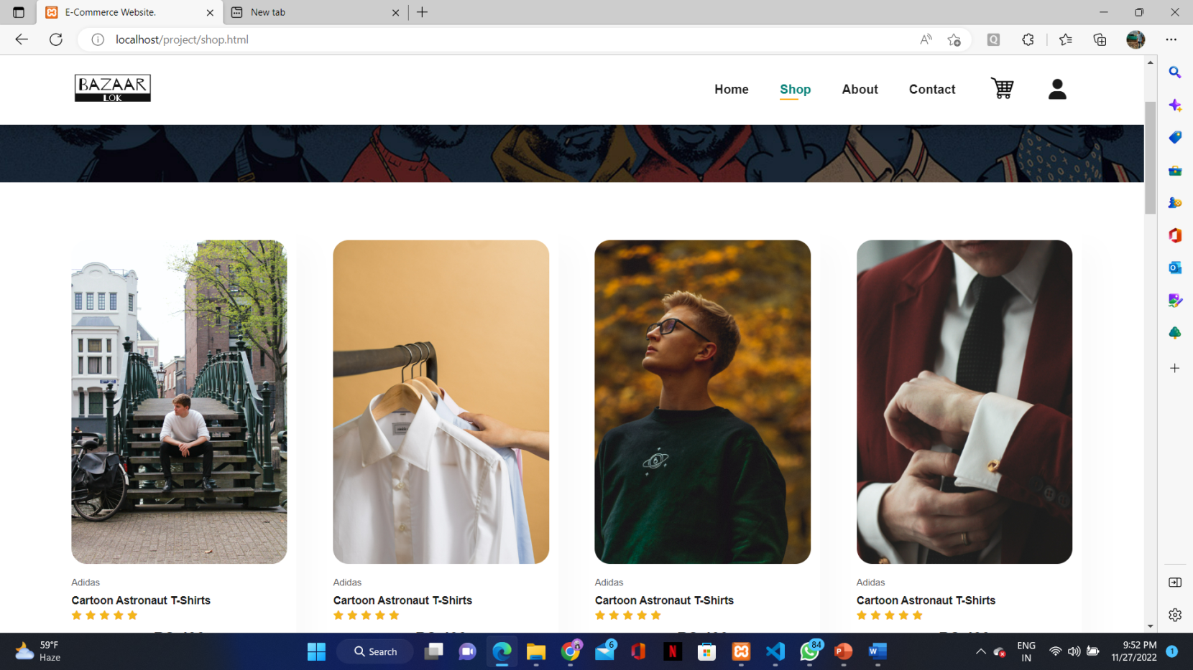
SHOP PAGE

Slide 11
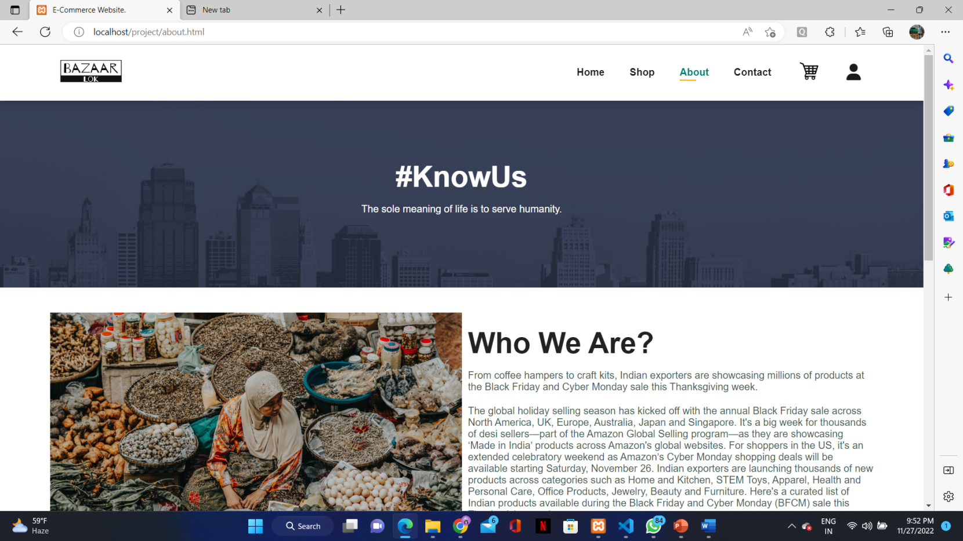
About page

Slide 12
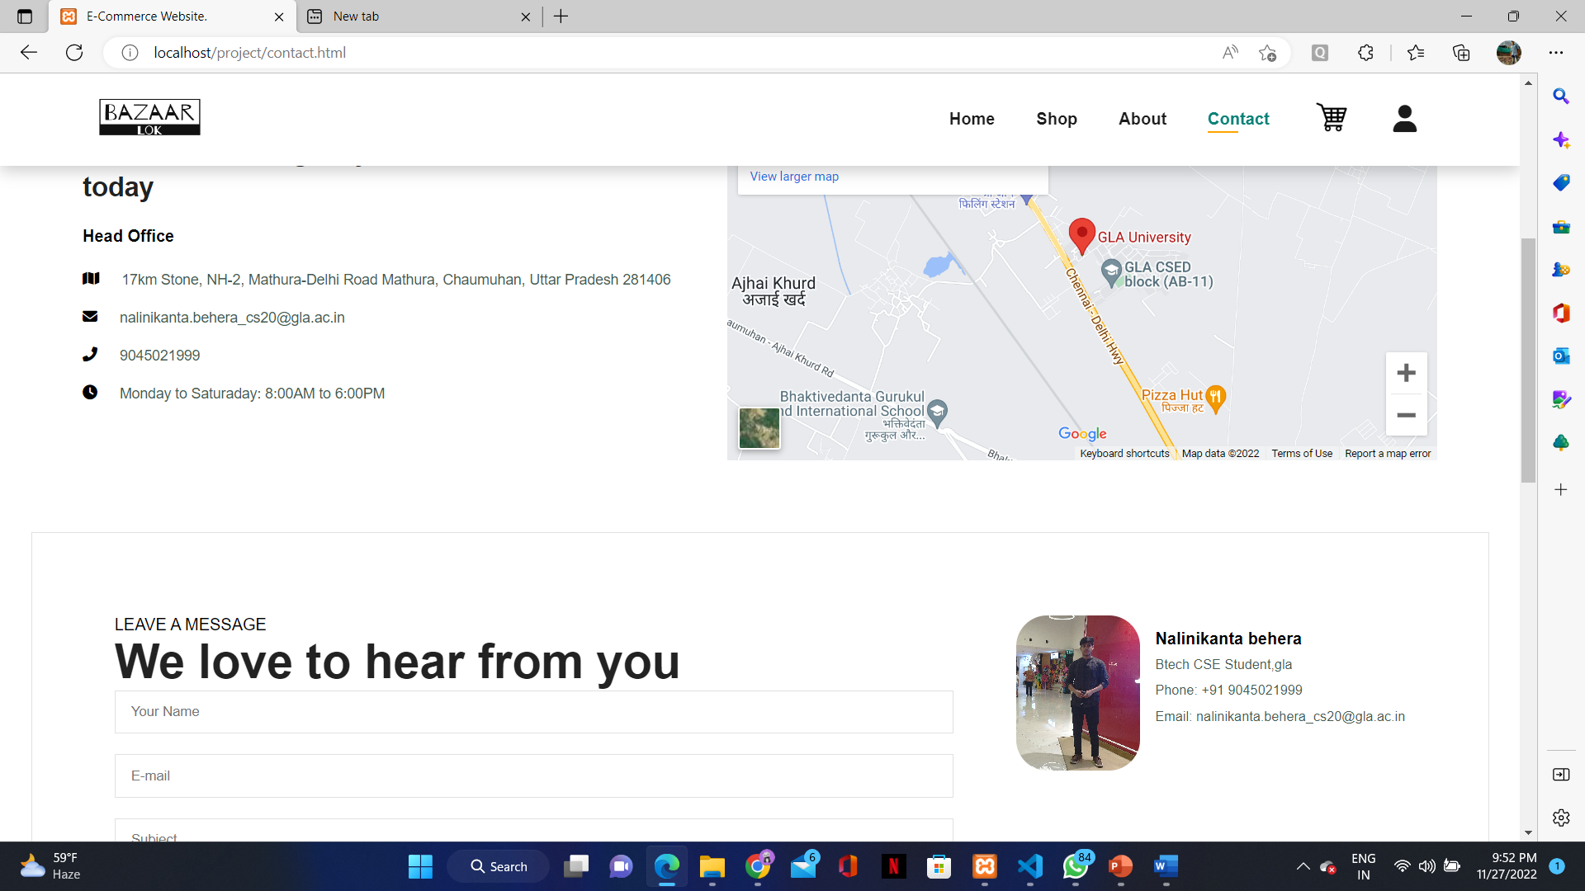
Contact page

Slide 13
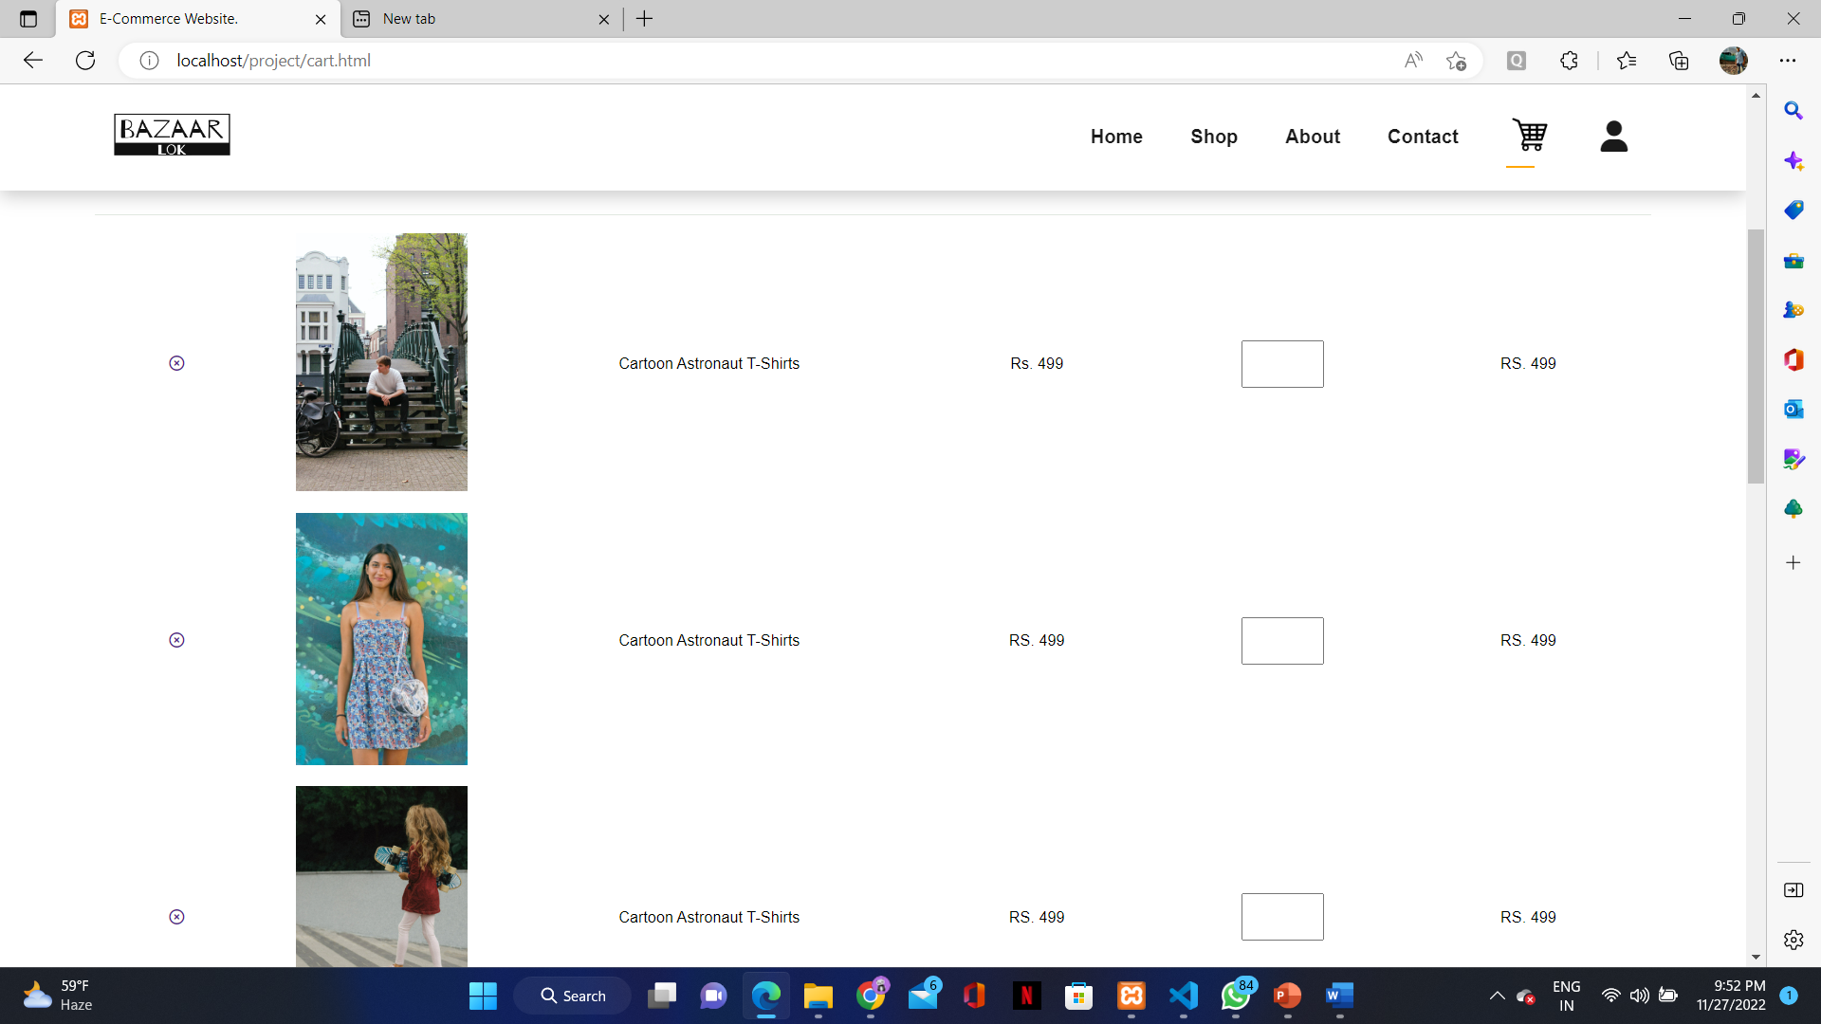
Cart page

Slide 14
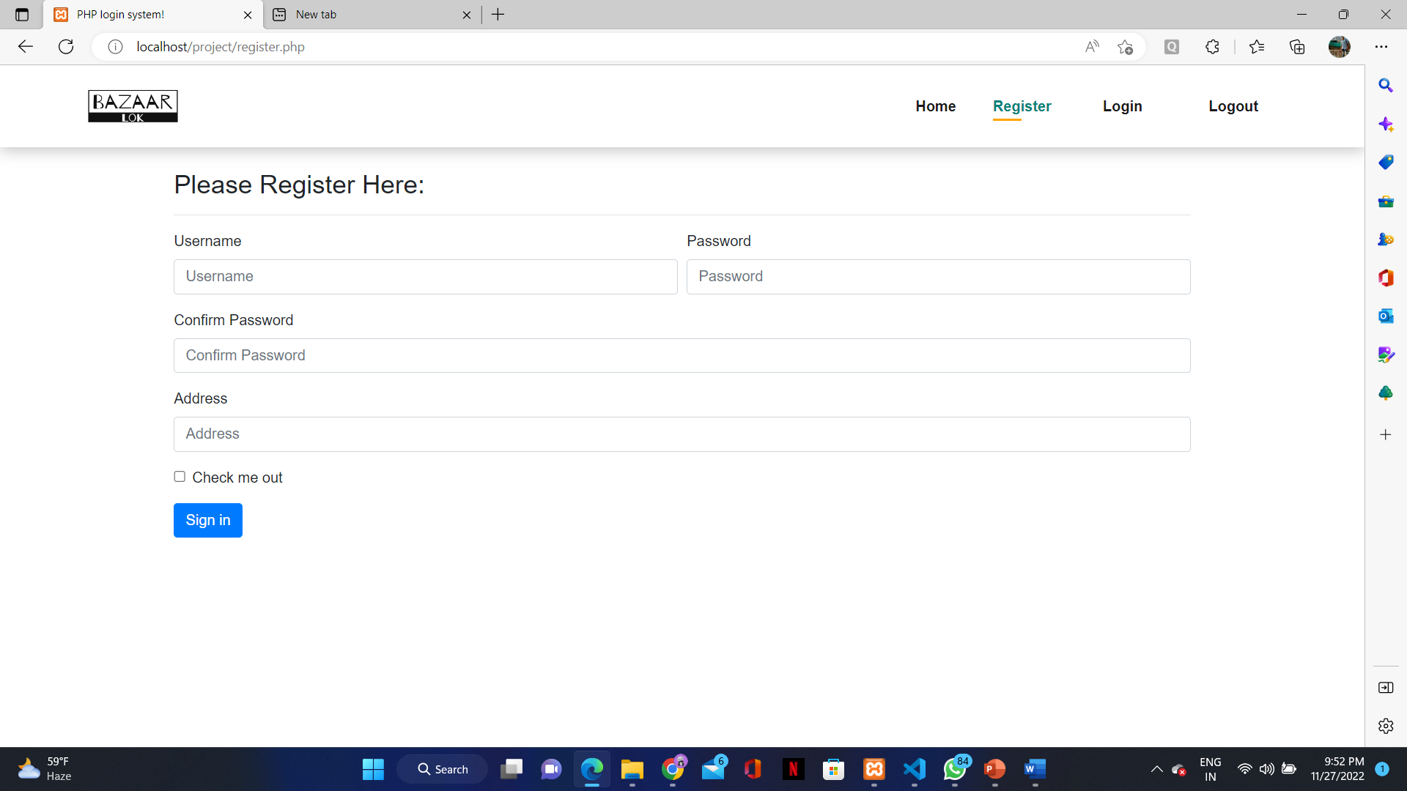
Login Page

Slide 15
Github link
https://github.com/gautamchitrans/miniproject-2.git

Slide 16
Thank you!

